Slide 1
Obesity Forecast: Predictive Modeling for BMI Trends
Group Members:
Prathyusha Kalepalli
Srinivas Minnakanti
Madhavi Muppani
Uttej Attili

Slide 2
Project analysis slide 2
Overview of Project Goals and Objectives
Prediction
Model Interpretation
PROJECT
Model Development
Model Comparison
Model Evaluation
Documentation & Reporting

Slide 3
Project analysis slide 3
Data Collection and Preprocessing
Data Transformation
Training – Validation Split
Data Quality Check
Feature Engineering
Validation
Cleansing
BMI
Recoding
Decoding
Normalization
Segregation
Partitioning

Slide 4
Project analysis slide 3
Variables in the dataset
The Obesity data set contains the following columns
Age
Height
Weight
Gender
Family history with overweight
Smoke
Obesity
Frequent consumption of high-calorie foods (FAVC)
Frequency of consumption of vegetables (FCVC)
Number of main meals (NCP)
Consumption of food between meals (CAEC)
Daily water consumption (CH20)
Alcohol consumption (CALC)
Monitoring calorie consumption (SCC),
Frequency of physical activity (FAF),
Time using technological devices (TUE),
Transportation used (MTRANS),
Data Transformation
Training – Validation Split
Data Quality Check
Feature Engineering
Validation
Cleansing
BMI
Recoding
Decoding
Normalization
Segregation
Partitioning

Slide 5
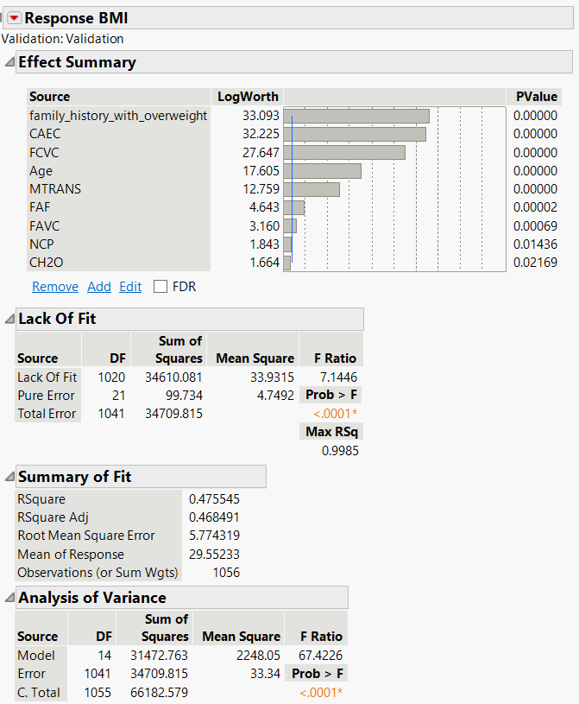
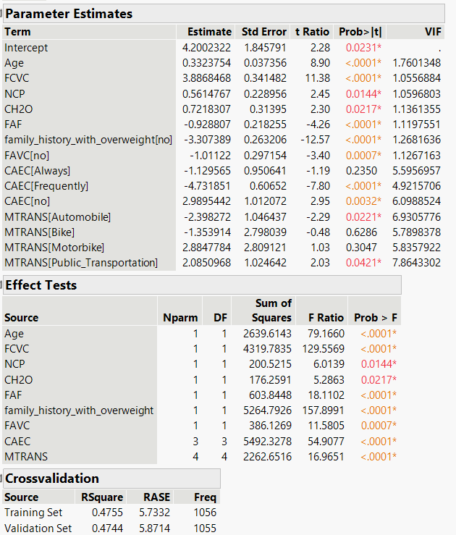
Project analysis slide 3
Model Development: Linear Regression
Final Model
Root Mean Squared Error (RASE) = 5.7 on the training set
RASE = 5.8, the validation set
Data Transformation
Training – Validation Split
Data Quality Check
Feature Engineering
Validation
Cleansing
BMI
Recoding
Decoding
Normalization
Segregation
Partitioning

Slide 6
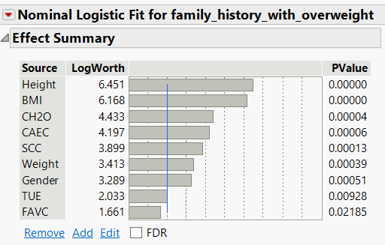
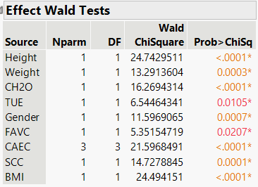
Project analysis slide 3
Model Development: Logistical Regression
Final Model
Data Transformation
Training – Validation Split
Data Quality Check
Feature Engineering
Validation
Cleansing
BMI
Recoding
Decoding
Normalization
Segregation
Partitioning

Slide 7
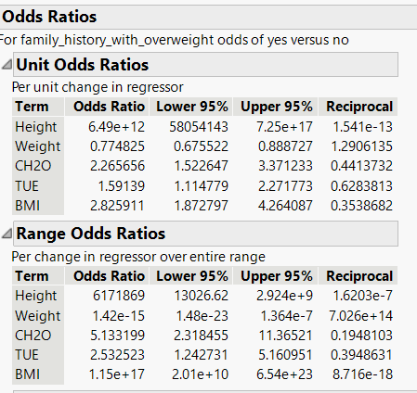
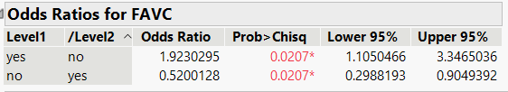
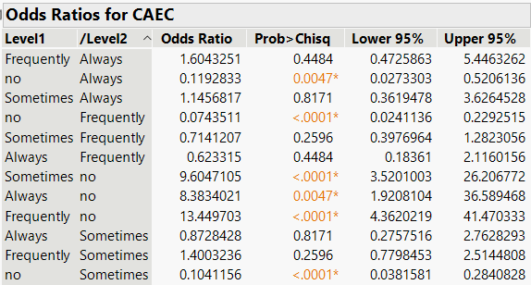
Project analysis slide 3
Model Development: Logistical Regression
Odd Ratios
Data Transformation
Training – Validation Split
Data Quality Check
Feature Engineering
Validation
Cleansing
BMI
Recoding
Decoding
Normalization
Segregation
Partitioning

Slide 8
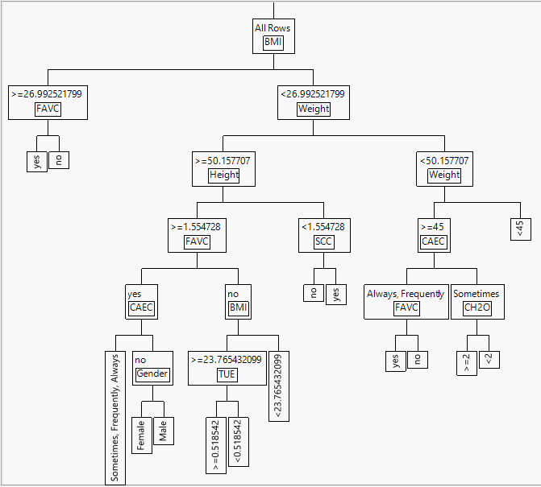
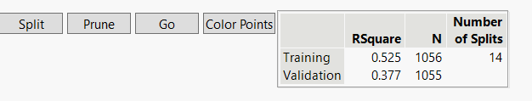
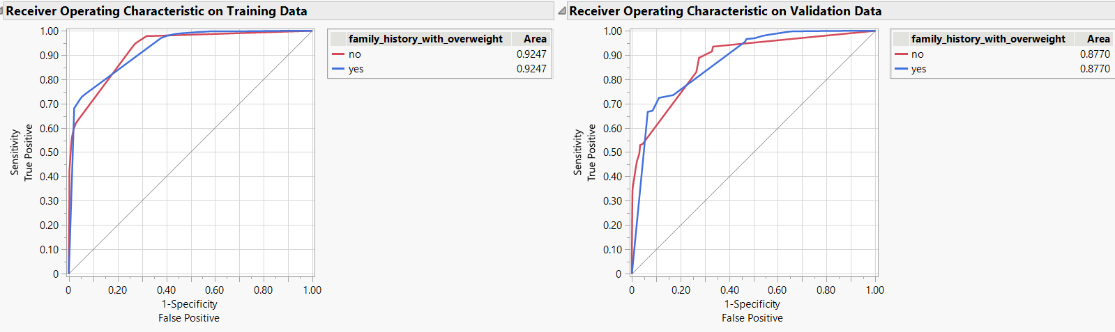
Project analysis slide 3
Model Development: Decision Tree
Number of Splits = 14
AUC= 0.8770
Data Transformation
Training – Validation Split
Data Quality Check
Feature Engineering
Validation
Cleansing
BMI
Recoding
Decoding
Normalization
Segregation
Partitioning

Slide 9
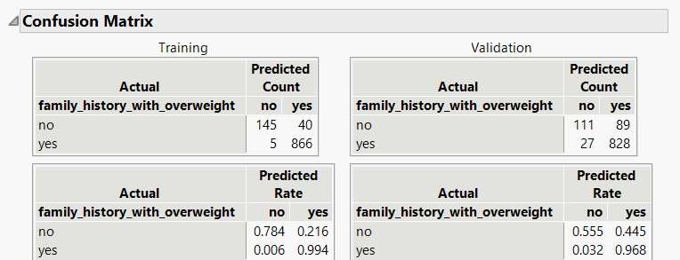
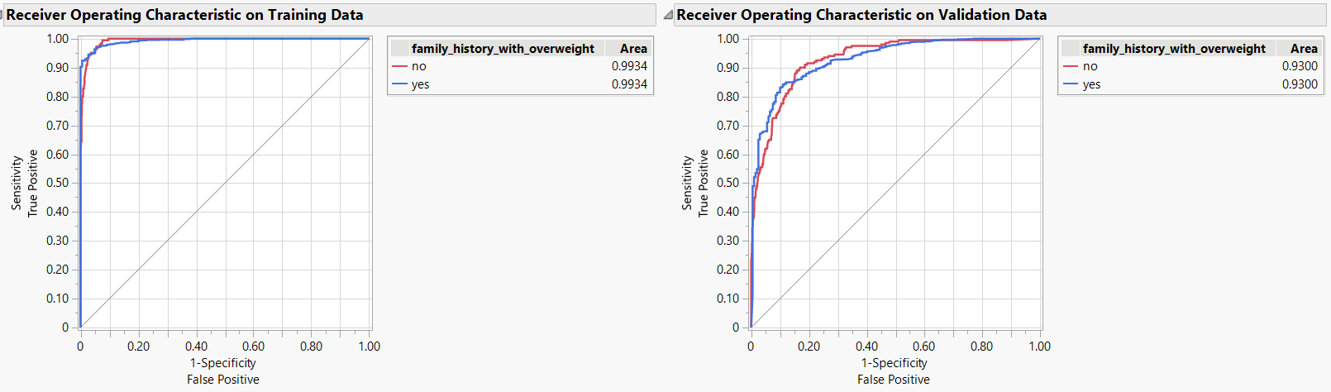
Project analysis slide 3
Model Development: Bootstrap Forest
AUC score = 0.9300
Data Transformation
Training – Validation Split
Data Quality Check
Feature Engineering
Validation
Cleansing
BMI
Recoding
Decoding
Normalization
Segregation
Partitioning

Slide 10
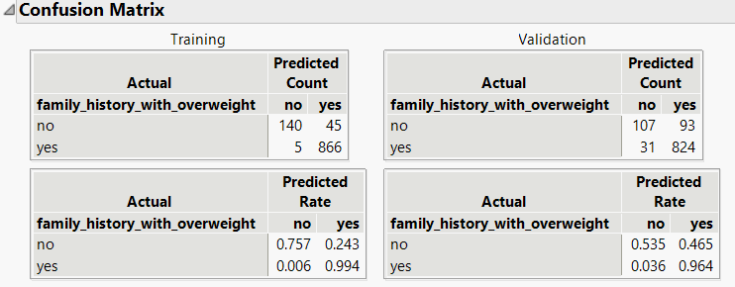
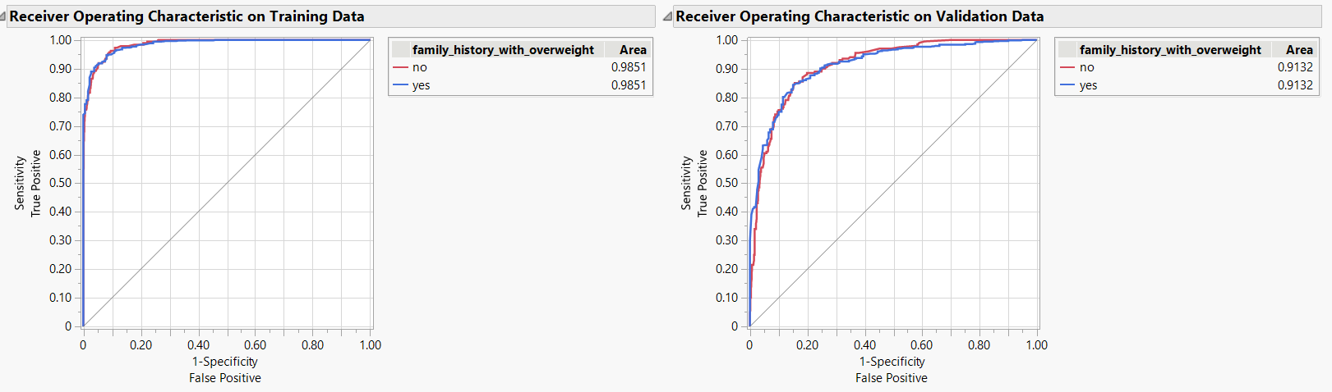
Project analysis slide 3
Model Development: Boosted Tree
AUC Score = 0.9132
Data Transformation
Training – Validation Split
Data Quality Check
Feature Engineering
Validation
Cleansing
BMI
Recoding
Decoding
Normalization
Segregation
Partitioning

Slide 11
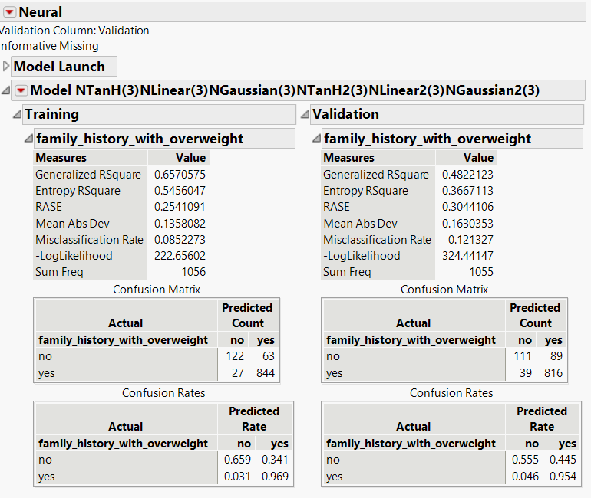
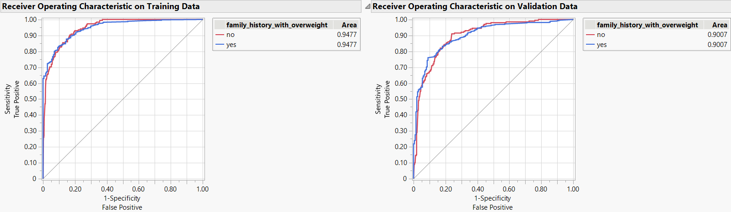
Project analysis slide 3
Model Development: Neural Network
AUC Score = 0.9007
Data Transformation
Training – Validation Split
Data Quality Check
Feature Engineering
Validation
Cleansing
BMI
Recoding
Decoding
Normalization
Segregation
Partitioning

Slide 12
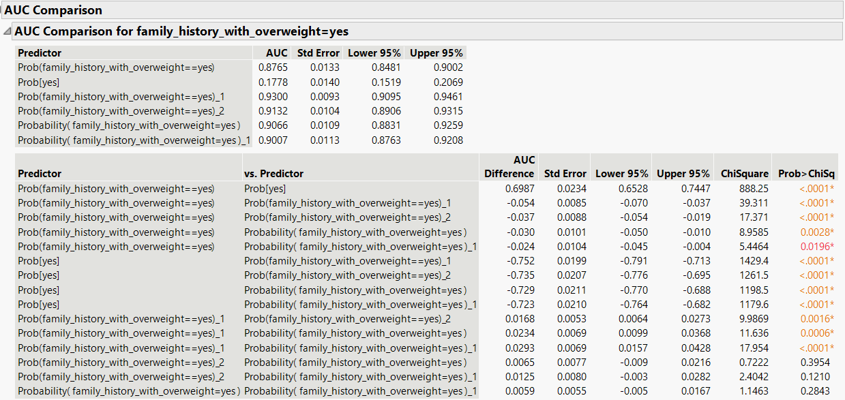
Project analysis slide 3
Model Development: Model Comparison
Data Transformation
Training – Validation Split
Data Quality Check
Feature Engineering
Validation
Cleansing
BMI
Recoding
Decoding
Normalization
Segregation
Partitioning

Slide 13
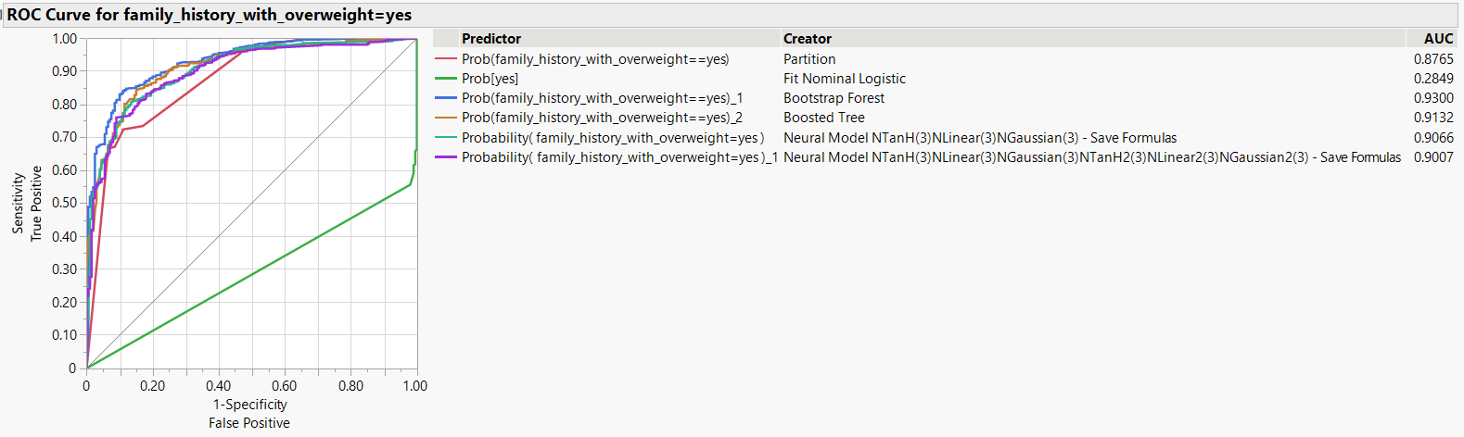
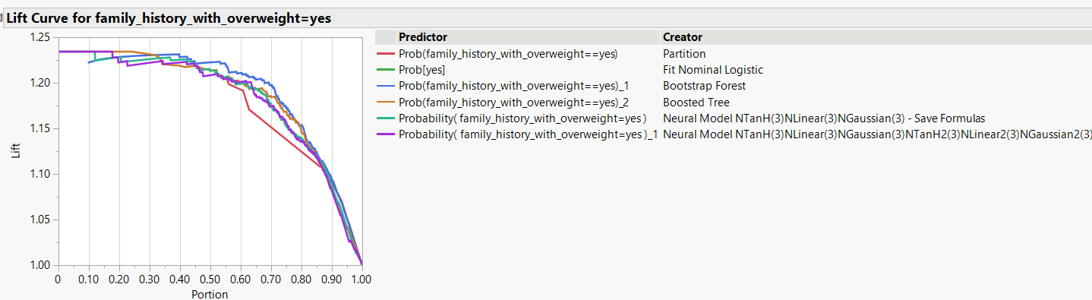
Project analysis slide 3
Model Development: Model Comparison
The model with TANH (3), NLINEAR(3), and NGAUSSIAN(3) activation functions achieves a competitive AUC of 0.9066.
The alternative neural network model, incorporating TANH2 (3), NLINEAR2 (3), and NGAUSSIAN2 (3) activations, performs slightly lower with an AUC of 0.9007.
Data Transformation
Training – Validation Split
Data Quality Check
Feature Engineering
Validation
Cleansing
BMI
Recoding
Decoding
Normalization
Segregation
Partitioning

Slide 14
Project analysis slide 11
Conclusion
Through an extensive evaluation of predictive models, our project reveals that leveraging family history significantly contributes to predicting obesity likelihood. The Bootstrap Forest model emerges as the most effective with highest AUC score among all other models, with a robust ability to identify individuals at risk.
This emphasizes the crucial role of familial predisposition in obesity prediction, paving the way for targeted interventions and policy initiatives aimed at curbing obesity rates and promoting personalized healthcare strategies.

Slide 15
Thank You

